Slide 1
How TPEx Helps Taiwan’s Micro & SME Access
The Capital Market
– Introduction of TPEx GISA Board
Notes:
1

Slide 2
Table of Contents
1. Taiwan’s Micro & SME Profile & Challenges
2. TPEx’s Role in Equity Crowdfunding &
Introduction to the GISA Board
3. Achievements of the GISA Board

Slide 3
Taiwan’s Micro & SME Profile -
SME Definition in Taiwan
Business Category | Employees | Paid-in Capital/ Revenue
SME Manufacturing, Construction, Mining, Businesses | <200 | <US$ 2,666,666 (Paid-in Capital)
SME Service, and Other Businesses | <100 | <US$ 3,333,333 (Revenue)
Micro Enterprise | <5 | No
OR
Source: Small and Medium Enterprises Administration, Ministry of Economic Affairs
Exchange Rate: 1 USD = 30 NTD

Slide 4
Taiwan’s SME Barriers to Funding
Financing Venue | Government Subsidies | Private Funds | Debt (Indirect Financing) | Capital Market (Direct Financing)
Type | R&D projects subsidy Innovative business projects subsidy | Venture capital Private equity | Loan from financial institution Funds from family or friends (grants or loans) | Equity – stocks, securities
Challenges for Taiwan SMEs | Limited amount of subsidy Heavy Compliance requirement from government | Startups are too small to attract proper VCs and angel investors Without adequate exposure to potential investors | Hard to obtain bank loan unless SMEs have a substantial financial record or valuable collateral High interest rate | Insufficient profit, capital size and corporate governance create barriers to access to capital market

Slide 5
The Ecosystem for Taiwan’s SMEs & Startups
Executive Yuan
Subsidized Loan
Training Program
Central Govern-ment
City Govern-ment
SMEA
IDB
COA
MOC
NDC
Specialized Institutions
Incubation Centers
ITRI
III
SMECGF
ACGF
CPC
Investor Fund
Demo Show & Contest
Subsidy

Slide 6
Table of Contents
1. Taiwan’s Micro & SME Profile & Challenges
2. TPEx’s Role in Equity Crowdfunding &
Introduction to the GISA Board
3. Achievements of the GISA Board

Slide 7
TPEx Provides Multi-tiered Equity Markets
Non-public Companies
Public
Companies
Main Board
Emerging Stock Board
(2002/1)
GISA
(2014/1/3)
Equity Crowdfunding
(2015/4/30)
It is critical for companies to choose the stock board or platform that most suits them.
Applying for Registration
Applying for Registration
IPO & Listing

Slide 8
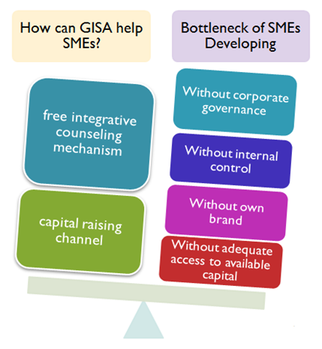
The GISA Board
The Go Incubation Board for Startup and Acceleration Firms (GISA) was established in January 2014 by Taipei Exchange (TPEx) to help small-sized innovative companies to grow and pave the way for future economic and industrial development.
Features of the GISA Board
designed as a platform for small-sized non-public companies.
provides integrated counseling for SMEs to improve their business operation.
enhances the confidence of potential investors to inject funds to innovative SMEs.

Slide 9
Mechanism of the GISA Board
Free counseling
Individual Investors
Investing cap: USD5,000 /year
Finance
Accounting
Internal Control
Small-sized innovative companies
Angel Investors*
No restri. on investment amount
Marketing
Taipei Exchange and related institutions provide integrative counseling
Disclose business operation plan and capital-raising info. on GISA
Regulations
Corporate Governance
Invest in small-sized innovative companies by subscribing to GISA
Qualified angel investors are one of the following: (1)a professional institutional investor, (2)a juristic person or fund that has shareholders equity exceeding USD1.66 million, (3)a trust enterprise, (4)a venture capital enterprise.

Slide 10
How to Become a GISA Company
Startups and SMEs Application
Integrative Counseling
First Capital Raising through GISA Platform
Innovation
Examination
Up to 2 Years Services
Counseling & Supervision
Comprehensive Examination
(1st stage)
Comprehensive Examination
(2nd stage)
Registering on GISA
Before being registered on the GISA board, integrative counseling services are provided for up to 2 years.
After being registered on the GISA board, free integrative counseling services are provided for up to 3 years.

Slide 11
Table of Contents
1. Taiwan’s Micro & SME Profile & Challenges
2. TPEx’s Role in Equity Crowdfunding &
Introduction to the GISA Board
3. Achievements of the GISA Board

Slide 12
Successful Case – Brinno’s IPO
邑錡 (Stock Code 7402)
Application Approval：November 27, 2013
Registered on GISA：Feb. 21, 2014
Capital Raised via GISA Capital Raising System：2.89 million (NTD 10/share)
# Employees：38
Registered on Emerging Stock Board：December 26, 2014 (NTD55/share)
Listed on TPEx Main Board：December 29, 2015
Capital Raised：122 millio (NTD76/share)
IPO Date：November 6, 2014

Slide 13
Successful Case – Fluxtek’s IPO
凡事康 (Stock Code 7443)
Application Approval：July 18, 2014
Registered on GISA：October 24, 2014
Capital Raised via GISA Capital Raising System：NTD 2 million (NTD20/share)
# Employees：89
Registered on Emerging Stock Board：Feb. 15, 2016 (NTD18/share)
IPO Date：April 29, 2015

Slide 14
Expanded Capital Access
Solid Investment Venue
TPEx GISA website:
http://www.tpex.org.tw/web/regular_emerging/Creative_emerging/Creative_emerging.php?l=en-us
GISA Information Disclosure System website:
http://mops.twse.com.tw/server-java/gotc/gotc_index
GISA Capital Raising System website:
http://gisa.gretai.org.tw/financing_s.htm

